Slide 1
Oregon Battle of the Books
2024-2025
3rd-5th Grade Division

Slide 2
What is OBOB?
OBOB stands for Oregon Battle of the Books!
The Battle of the Books is a friendly reading competition. You will get into teams of 4-5 students and read a list of 16 books. You do NOT have to read all 16 unless you want to! I suggest reading about 4 or 5 of the books. To battle, your team will compete against one other team answering questions about the books from the list.
Team sign up will begin in October, and ACCESS OBOB battles will be sometime in February!

Slide 3

The Books!

Slide 4
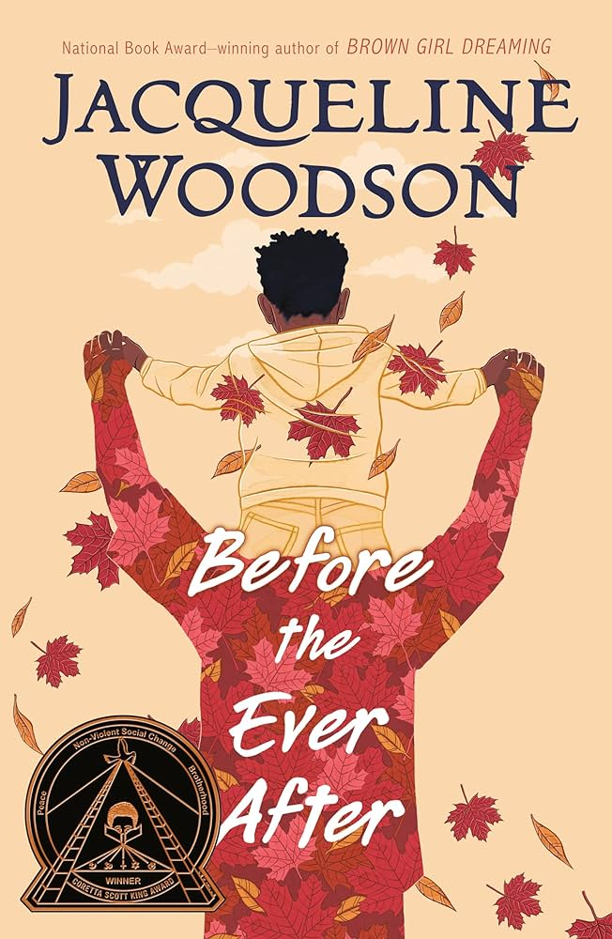
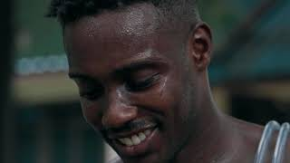
Before the Ever After
by Jacqueline Woodson
Before the Ever After is a poignant novel that explores the impact of chronic traumatic encephalopathy (CTE) on a family. Told from the perspective of a young boy whose father is a former NFL player suffering from the effects of CTE, the book delves into themes of love, loss, and the power of family bonds.

Slide 5

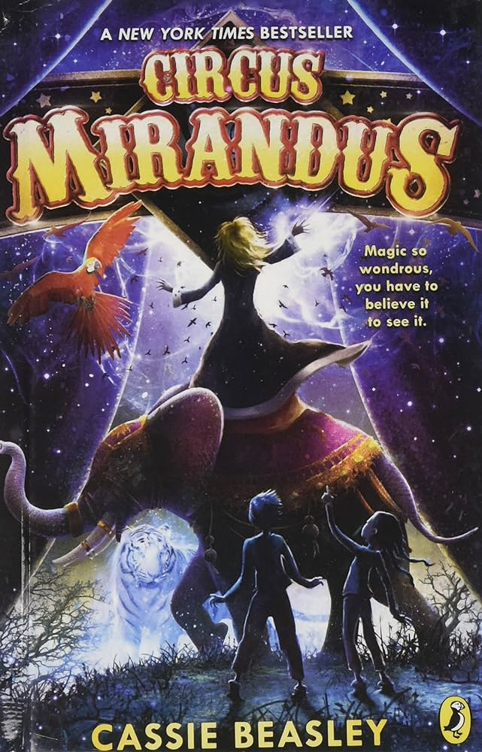

Circus Mirandus
by Cassie Beasley
Micah’s beloved grandfather is sick, but all is not lost. Years ago, his grandfather visited a mysterious circus where he was promised a miracle by a man who could bend light. But who is this stranger, will he keep his promise, and does the magical Circus Mirandus really exist?

Slide 6
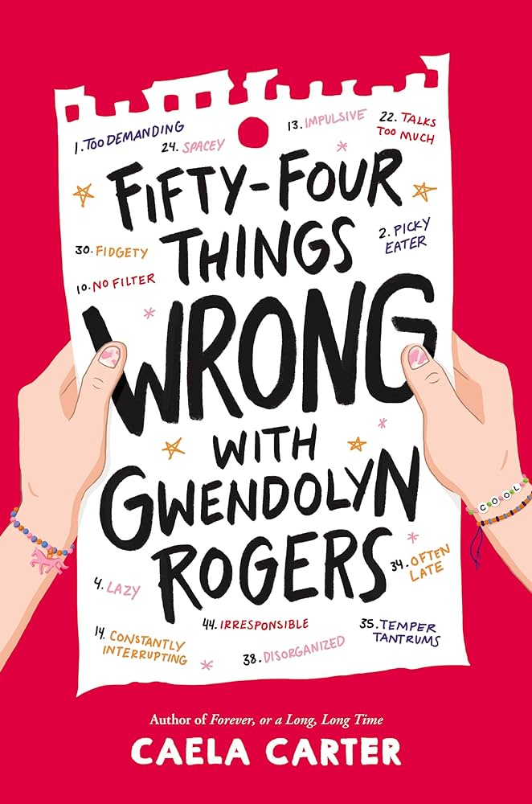
Fifty-Four Things Wrong with Gwendolyn Rogers by Caela Carter
No one can figure out what Gwendolyn Rogers’ problem is—not her mom, or her teachers, or any of the many therapists she’s seen. But Gwendolyn knows she doesn’t have just one thing wrong with her: she has fifty-four. At least, according to a confidential school report (that she read because she is #16. Sneaky, not to mention #13. Impulsive). So Gwendolyn needs a plan, because if she doesn’t get these fifty-four things under control, she’s not going to be able to go to horse camp this summer with her half-brother, Tyler. But Tyler can’t help her because there’s only one thing “wrong” with him: ADHD. And her best friend Hettie can’t help her because there’s nothing wrong with Hettie. She’s perfect.
So Gwendolyn is hopeless until she remembers the one thing that helped her mother when her own life was out of control. Or actually, the twelve things. Can these Twelve Steps that cured her mother somehow cure Gwendolyn too?

Slide 7



Frizzy by Claribel A. Ortega
and Rose Bousamra
Marlene loves three things: books, her cool Tía Ruby and hanging out with her best friend Camila. But according to her mother, Paola, the only thing she needs to focus on is school and "growing up." That means straightening her hair every weekend so she could have "presentable", "good hair".
But Marlene hates being in the salon and doesn't understand why her curls are not considered pretty by those around her. With a few hiccups, a dash of embarrassment, and the much-needed help of Camila and Tia Ruby—she slowly starts a journey to learn to appreciate and proudly wear her curly hair.

Slide 8
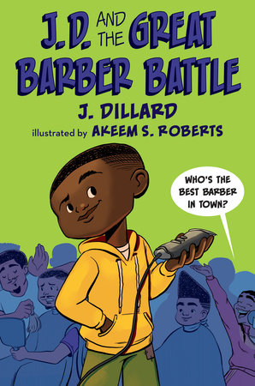
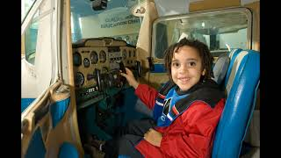
J.D. and the Great Barber Battle
by J. Dillard
J.D. has a big problem--it's the night before the start of third grade and his mom has just given him his first and worst home haircut. When the steady stream of insults from the entire student body of Douglass Elementary becomes too much for J.D., he takes matters into his own hands and discovers that, unlike his mom, he's a genius with the clippers. His work makes him the talk of the town and brings him enough hair business to open a barbershop from his bedroom. But when Henry Jr., the owner of the only official local barbershop, realizes he's losing clients to J.D., he tries to shut him down for good. How do you find out who's the best barber in all of Meridian, Mississippi? With a GREAT BARBER BATTLE!

Slide 9
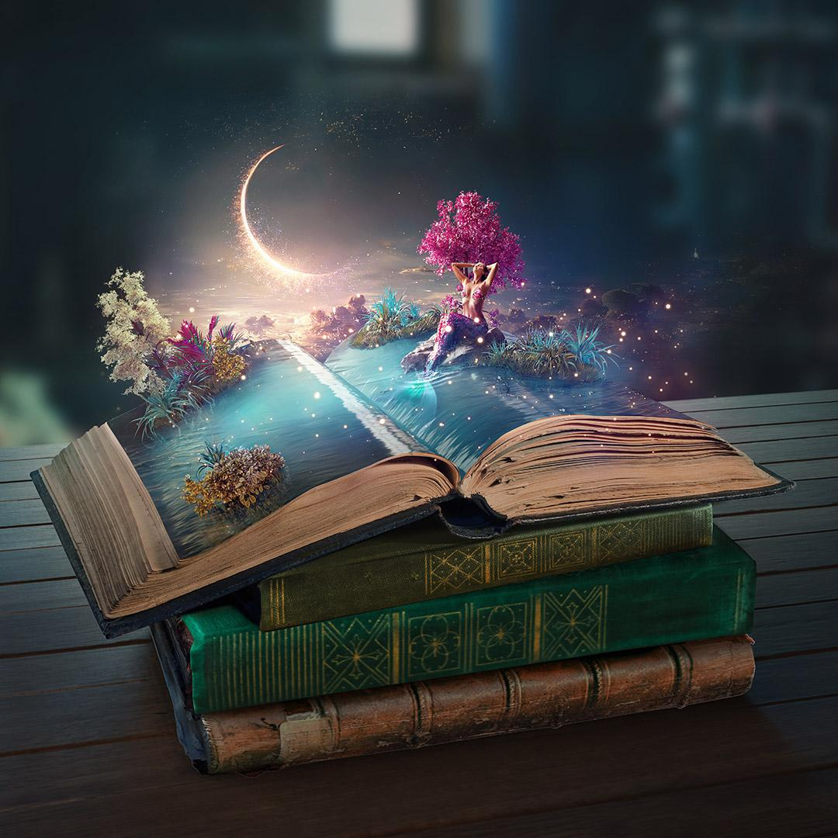
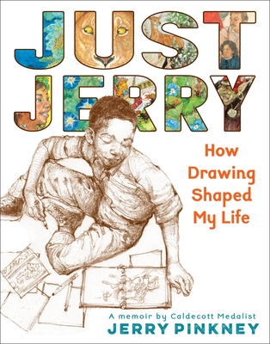
Just Jerry: How Drawing Shaped My Life by Jerry Pinkney
Jerry Pinkney drew everywhere, all the time. It was how he made sense of the world—how he coped with the stress of being a sensitive child growing up in crowded spaces, struggling with a learning disability, in a time when the segregation of Black Americans was the norm. Only drawing could offer him a sense of calm, control, and confidence. When friends and siblings teased him about having the nickname “Jerry” as his only name, his mother always said, “Just ‘Jerry’ is enough. He’ll make something of that name someday.” And so he did, eventually becoming one of the most celebrated children’s book illustrators of all time and paving the way for countless other Black artists.
Jerry’s vivid recollections and lively sketchbook drawings of his youth in postwar America tell an inspiring story of how a hardworking boy pursued his passion in less-than-ideal circumstances and became a legendary artist against all odds.

Slide 10
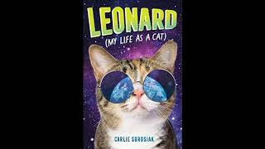
Leonard (My Life as a Cat)
by Carlie Sorosiak
Leonard has never had a name. Or a body. Or a best friend. But he is excited to try being a human.
On their three-hundredth-birthday, every alien from Leonard's home galaxy gets to spend a month in the body of an Earth Creature. Leonard was supposed to become a forest ranger in Yellowstone National Park - but there was a mix-up.
And now he's stuck as a stray cat.
Luckily for Leonard, he meets a young human called Olive -
and together they set out on a journey to find home.

Slide 11
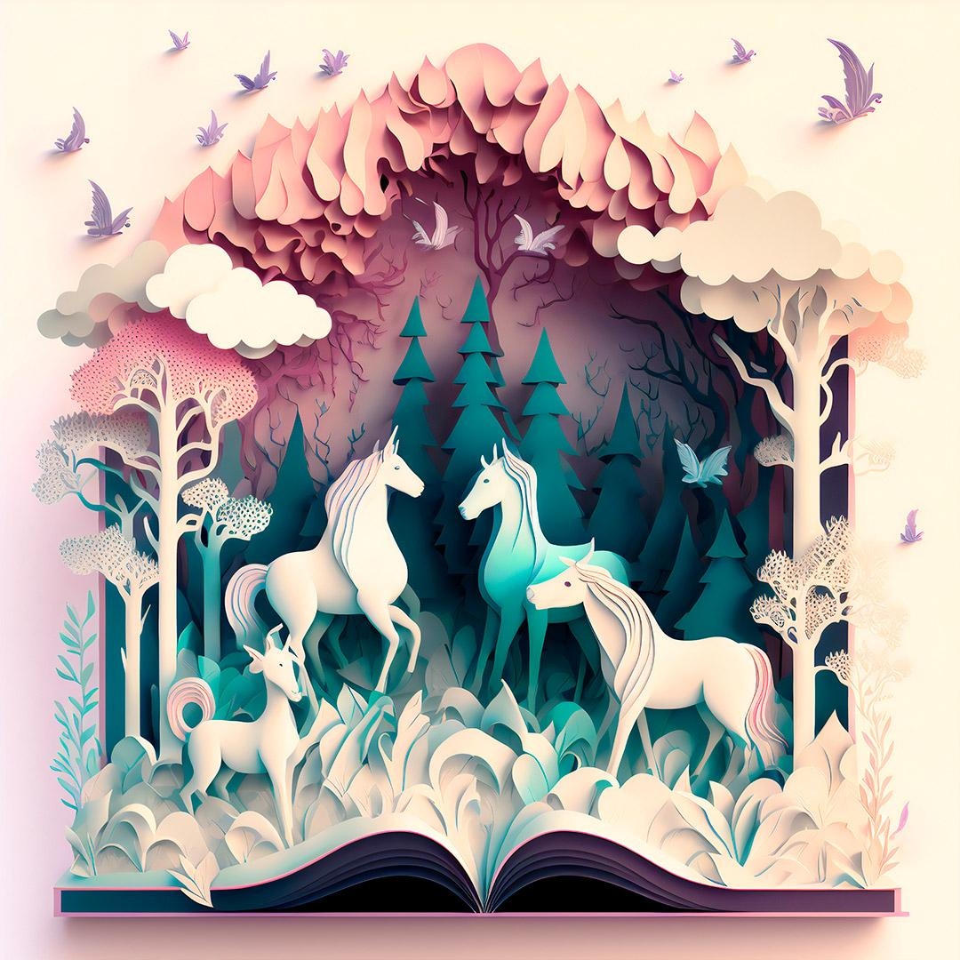
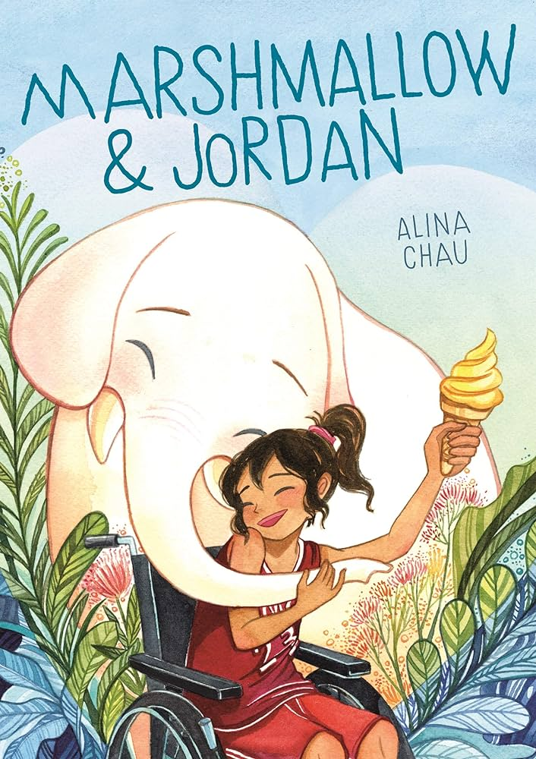
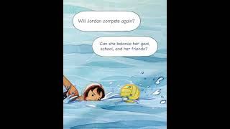
Marshmallow & Jordan by Alina Chau
Jordan's days as star player for her school's basketball team ended when an accident left her paralyzed from the waist down. Now, she's still the team captain, but her competition days seem to be behind her...until an encounter with a mysterious elephant, who she names Marshmallow, helps Jordan discover a brand new sport.
Will water polo be the way for Jordan to continue her athletic dreams--or will it just come between Jordan and her best friends on the basketball team? And with the big tournament right around the corner, what secret is Marshmallow hiding?

Slide 12

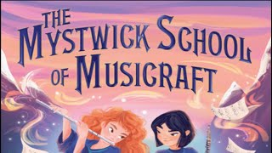
The Mystwick School of Musicraft by Jessica Khoury
Amelia Jones always dreamed of attending the Mystwick School of Musicraft, where the world’s most promising musicians learn to create magic. So when Amelia botches her audition, she thinks her dream has met an abrupt and humiliating end—until the school agrees to give her a trial period. Amelia is determined to prove herself, vowing to do whatever it takes to become the perfect musician. Even if it means pretending to be someone she isn’t.
Meanwhile, a mysterious storm is brewing that no one, not even the maestros at Mystwick, is prepared to contain. Can Amelia find the courage to be true to herself in time to save her beloved school from certain destruction?

Slide 13
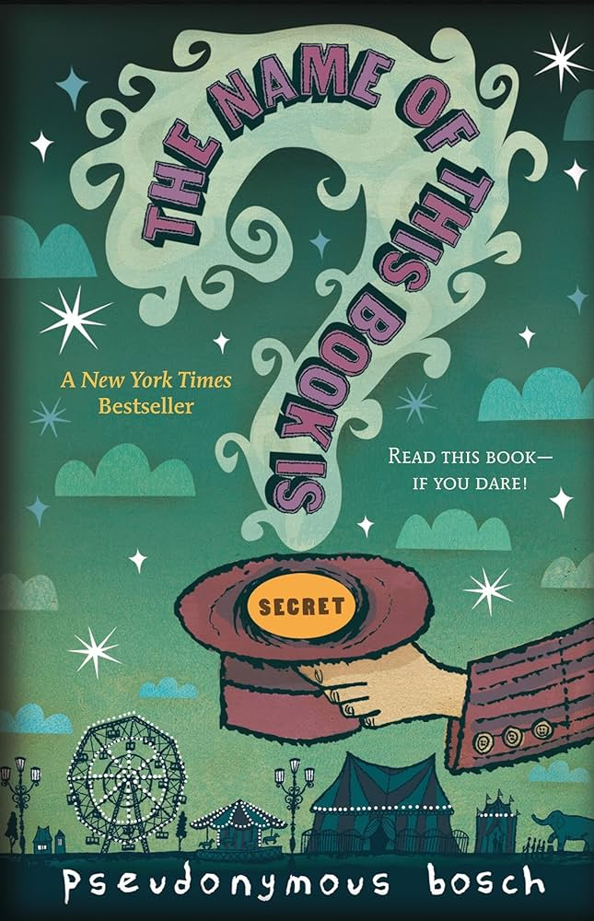
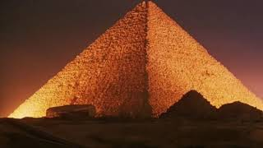
The Name of This Book Is Secret by Pseudonymous Bosch
As much as he'd love to sing the praises of his book (he is very vain), he wouldn't want you to hear about his brave 11-year old heroes, Cass and Max-Ernest. Or about how a mysterious box of vials, the Symphony of Smells, sends them on the trail of a magician who has vanished under strange (and stinky) circumstances. And he certainly wouldn't want you to know about the hair-raising adventures that follow and the nefarious villains they face. You see, not only is the name of this book secret, the story inside is, too. For it concerns a secret. A Big Secret.

Slide 14

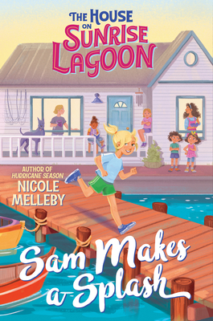
Sam Makes a Splash by Nicole Melleby
If you want to get to know eleven-year-old Samantha Ali-O’Connor, you need to know three things:
One, she isn’t the only one of her siblings who is adopted, but she is the only one whose name isn't inspired by the ocean.
Two, she and Harbor always compete with each other to be the best Oldest Sibling—and just about everything else.
And three, she is determined to prove she's a real Ali-O'Connor by taking over the family business, repairing and chartering boats.
Except there's a Capital-P Problem: Her mothers have been Serious Whispering about selling the business before summer's end! Sam needs to come up with a plan, quick, before Harbor finds out. And before Sam loses her chance to inherit the business and be an Ali-O'Connor forever.

Slide 15

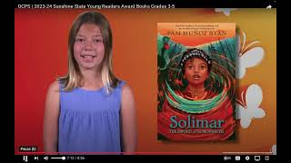
Solimar: The Sword of the Monarchs by Pam Muñoz Ryan
On the brink of her Quinceañera, and her official coronation, Solimar visits the oyamel forest to sit among the monarch butterflies. There, the sun pierces through a sword-shaped crevice in a boulder, which shines on her and sends the butterflies humming and swirling around her. After the magical frenzy, she realizes she's been given a gift—and a burden: she can predict the near future! She has also become a protector of the young and weak butterflies. This alone would be a huge responsibility, but tragedy strikes when a neighboring king invades while her father and brother and many others are away. The remaining villagers are taken hostage—all except Solimar. Can this princess-to-be save her family, the kingdom, and the future of the monarch butterflies from a greedy and dangerous king? Written for ages 8 to 12 by the Newbery Honor Medal winner of the highly acclaimed novel Echo.

Slide 16
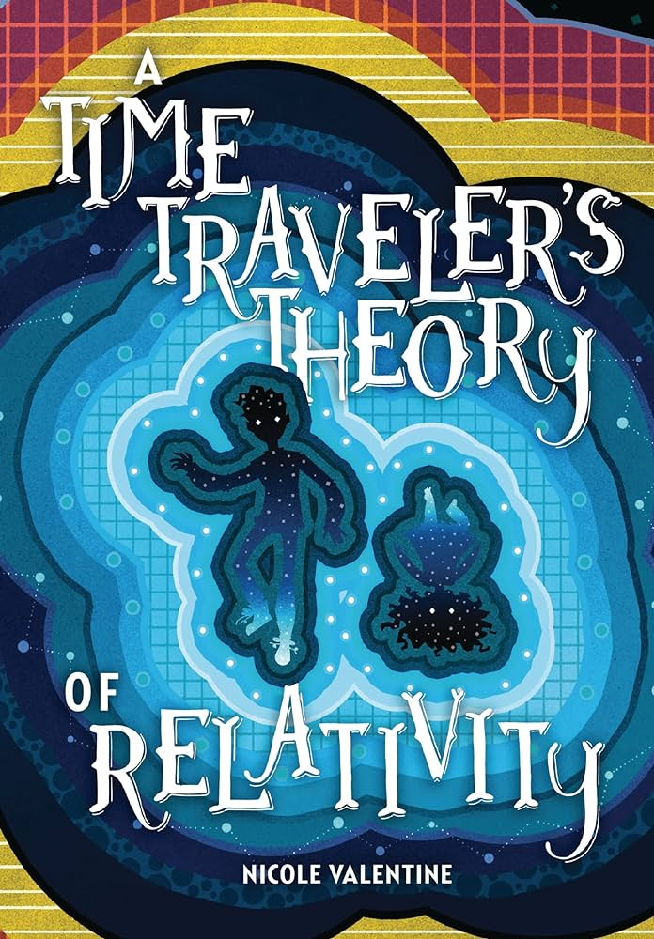
A Time Traveler’s Theory of Relativity by Nicole Valentine
He believes in science, but only magic can help his mom.
Twelve-year-old Finn is used to people in his family disappearing. His twin sister, Faith, drowned when they were three years old. A few months ago, his mom abandoned him and his dad with no explanation. Finn clings to the concrete facts in his physics books—and to his best friend, Gabi—to ward off his sadness. But then his grandmother tells him a secret: the women in their family are Travelers, able to move back and forth in time.
Finn's mom is trapped somewhere in the timeline, and she's left Finn a portal to find her. But to succeed, he'll have to put his trust in something bigger than logic.

Slide 17

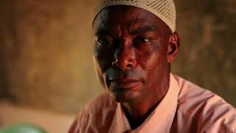
Thirst
by Varsha Bajaj
Minni lives in the poorest part of Mumbai, where access to water is limited to a few hours a day and the communal taps have long lines. Lately, though, even that access is threatened by severe water shortages and thieves who are stealing this precious commodity—an act that Minni accidentally witnesses one night. Meanwhile, in the high-rise building where she just started to work, she discovers that water streams out of every faucet and there’s even a rooftop swimming pool. What Minni also discovers there is one of the water mafia bosses. Now she must decide whether to expose him and risk her job and maybe her life. How did something as simple as access to water get so complicated?

Slide 18
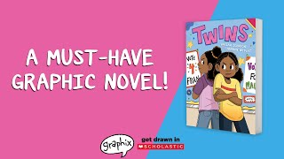
Twins by Varian Johnson and Shannon Wright
Maureen and Francine Carter are twins and best friends. They participate in the same clubs, enjoy the same foods, and are partners on all their school projects. But just before the girls start sixth grade, Francine becomes Fran -- a girl who wants to join the chorus, run for class president, and dress in fashionable outfits that set her apart from Maureen. A girl who seems happy to share only two classes with her sister! Maureen and Francine are growing apart and there's nothing Maureen can do to stop it. Are sisters really forever? Or will middle school change things for good?

Slide 19
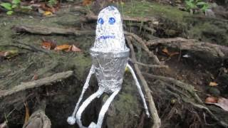
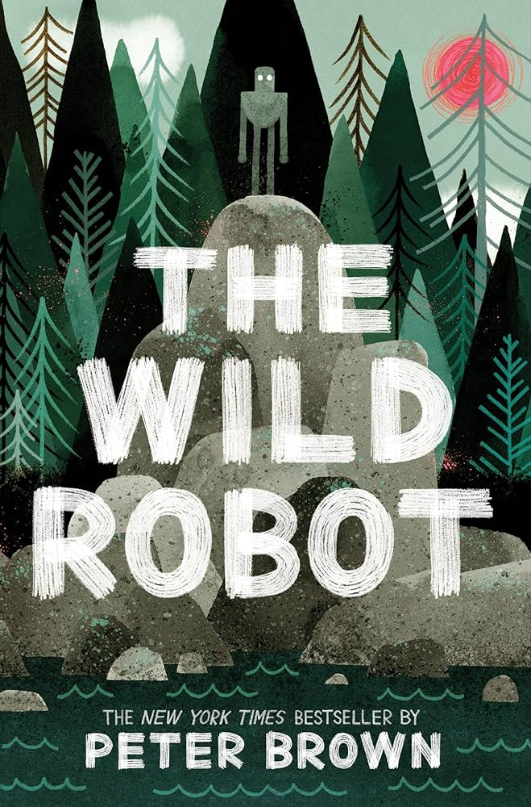

The Wild Robot
by Peter Brown
Bonus: Movie Trailer:
Can a robot survive in the wilderness?
When robot Roz opens her eyes for the first time,
she discovers that she is all alone on a remote, wild island. She has no idea how she got there or what her purpose is--but she knows she needs to survive. After battling a violent storm and escaping a vicious bear attack, she realizes that her only hope for survival is to adapt to her surroundings and learn from the island's unwelcoming animal inhabitants.
As Roz slowly befriends the animals, the island starts to feel like home--until, one day, the robot's mysterious past comes back to haunt her.
From bestselling and award-winning author and illustrator Peter Brown comes a heartwarming and action-packed novel about what happens when nature and technology collide.

